Slide 1
Ch 5. Data Structures Pt. 1
Arrays
2. Arrays, Methods, and User Interaction
Pg. 53 - 54

Slide 2
Array Declaration
<data_type>[] <id> = new <data_type>[<capacity>];
int[] myArray = new int[5];
int[] myArray = new int[5];
27
14
23
85
33
0 1 2 3 4
int length = myArray.length;
int num = myArray[2];

Slide 3
Accessing an array
27
14
23
85
33
for(int i = 0; i < myArray.length; i++){
System.out.println(i+":"+myArray[i]);
}

Slide 4
Create a program called
ArraysAndMethods.java
- Ask the user to enter the total number of scores to store.
- Ask for each score and store them in an array of ints.
- Print the contents of the array.
- Perform the average and the final grade (letter grade).

Slide 5
Translate the code into methods
/** 1) print()
This method will take an array of ints as a parameter and it will print the content of the array provided in the parameter.*/
/** 2) getAVG()
This method will take an array of ints as a parameter and it will return a double (representing the calculated average).*/

Slide 6
Translate the code into methods
/** 3) getGradeByAVG()
This method will take a double as a parameter (average) and it will return a character representing the letter grade .*/
/** 4) findMaxGrade()
The method will take an array of ints as a parameter and it will return the largest value from the array.*/

Slide 7
Output
PS C:\Users\...\desktop> javac ArraysAndMethods.java
PS C:\Users\...\desktop> java ArraysAndMethods
Enter the total number of scores: 2
Score: 100
Score: 95
Scores: 100, 95
Sum: 195.0
Average grade: 97.5
Letter grade: A
Highest score: 100

Slide 8
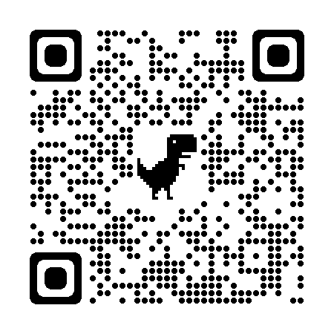
Resources

